Slide 1
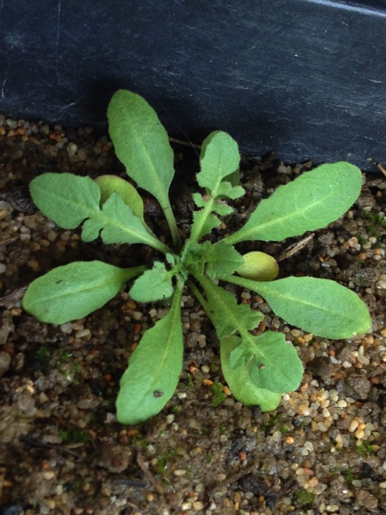
Notes:
Centaurea solstitialis?

Slide 2
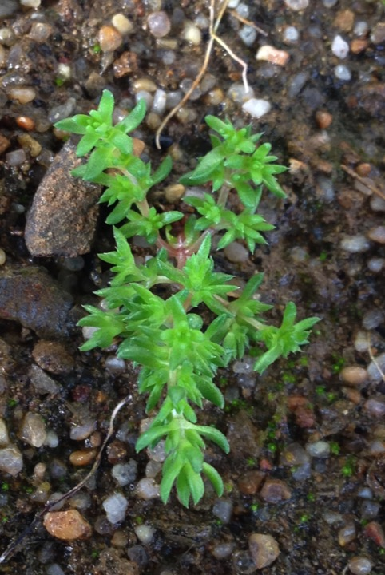
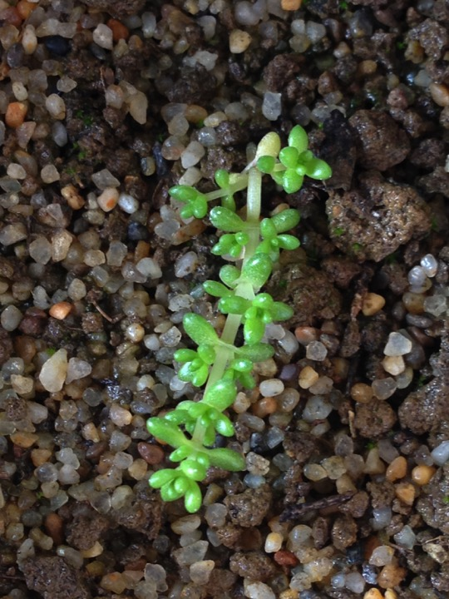
Notes:
Crassula connata? – the picture on the left is more consistent with the seedling guide, but it’s been really dense in plots with no record of crassula. Also the leaves on these two look very different.

Slide 3
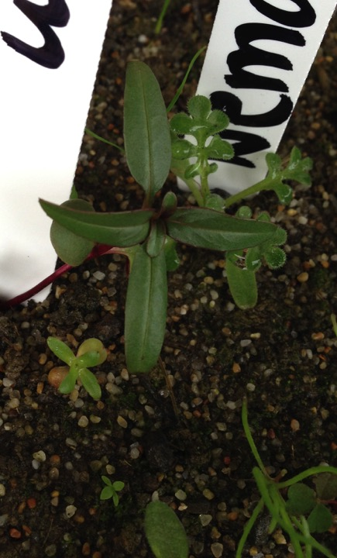
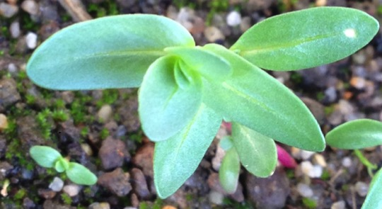
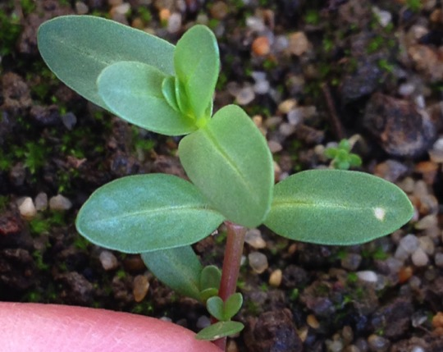
Notes:
I previously tagged the left picture as epilobium brachycarpum based on the seedling guide but now I’m thinking the one on the right is Epilobium and the left one is Apocynum?

Slide 4
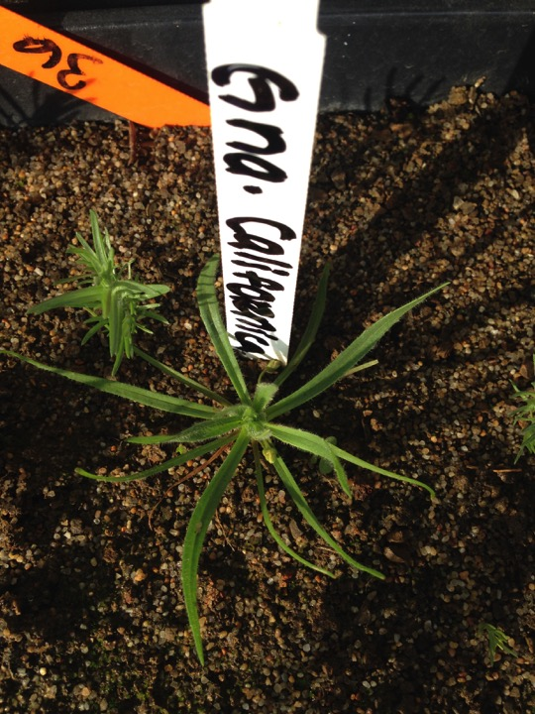
Notes:
Gnaphalium californicum?

Slide 5
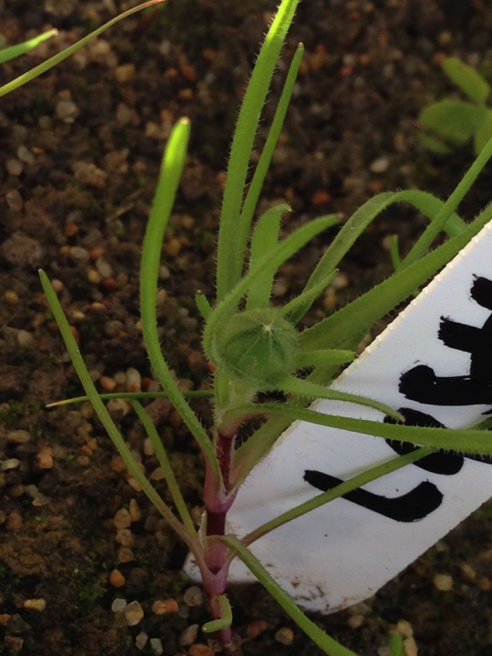
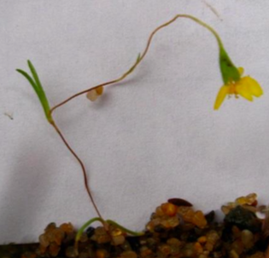
Notes:
Left - Lasthenia californica? – looks different from seedling guide picture (on right)

Slide 6
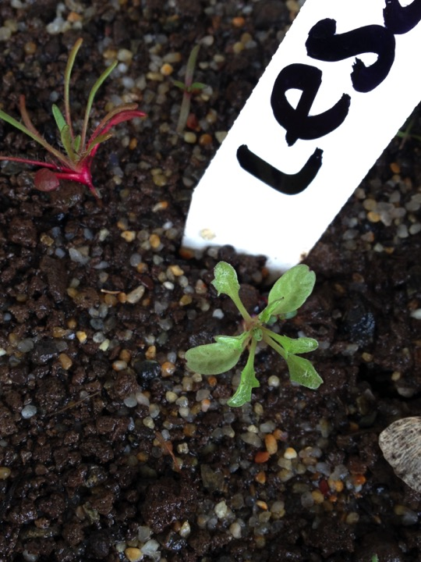
Notes:
Lessingia ramulosa

Slide 7
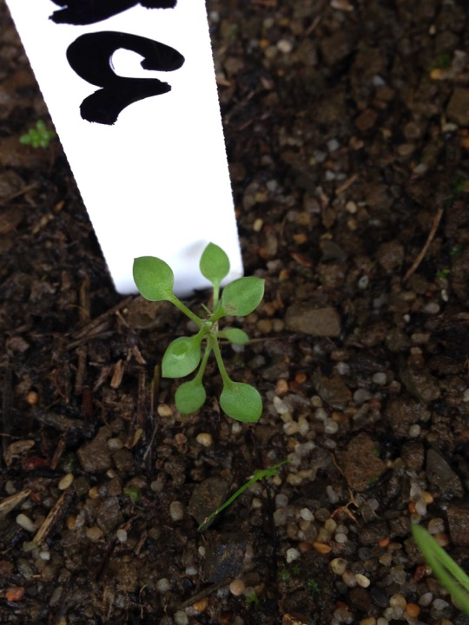
Notes:
Stellaria nitens?

Slide 8
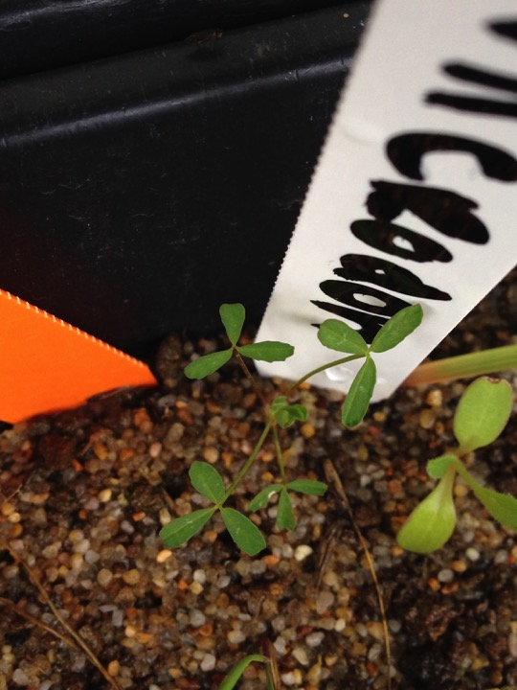
Notes:
Trifolium microdon?

Slide 9
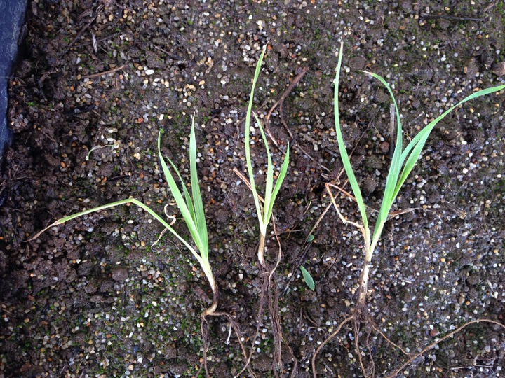
Notes:
Elytrigia repens? – found in plot 80 – Other grasses in this plot are avena, bromus hordeaceus, bromus madritensis, and medusahead. Not hairy, no seed present…

Slide 10
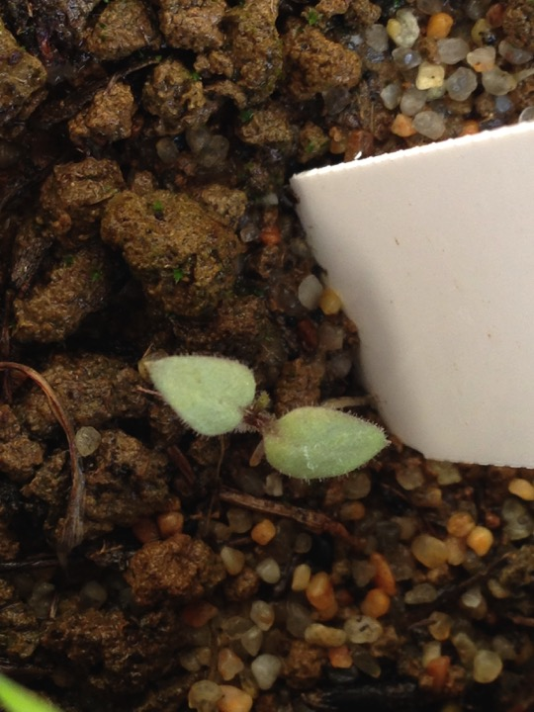

Slide 11
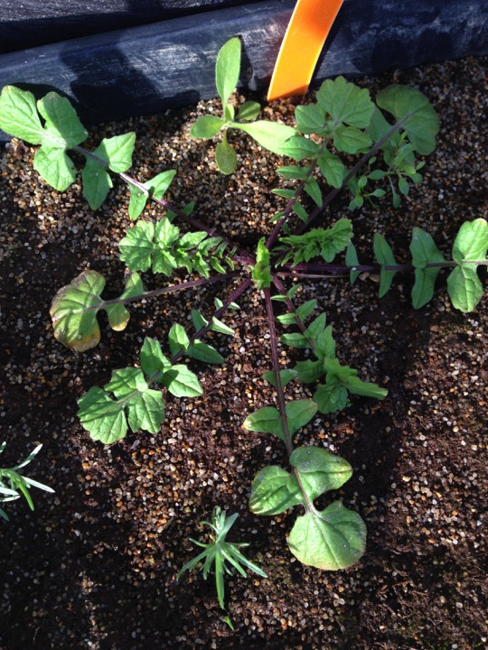

Slide 12
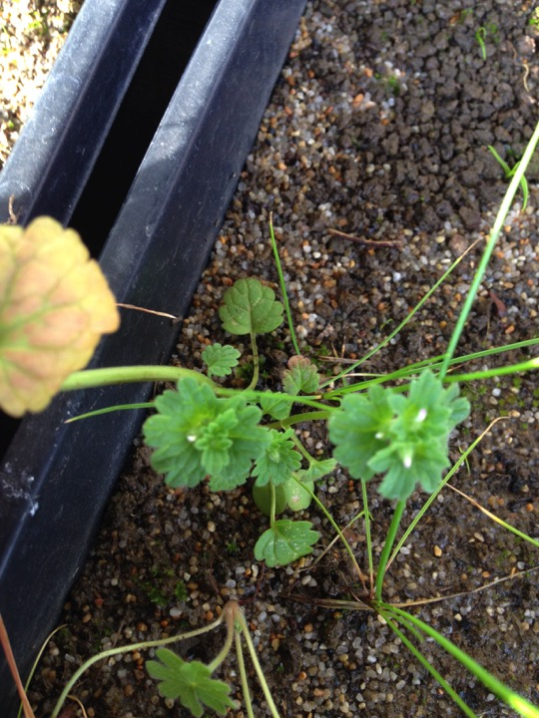
Notes:
Square stem

Slide 13
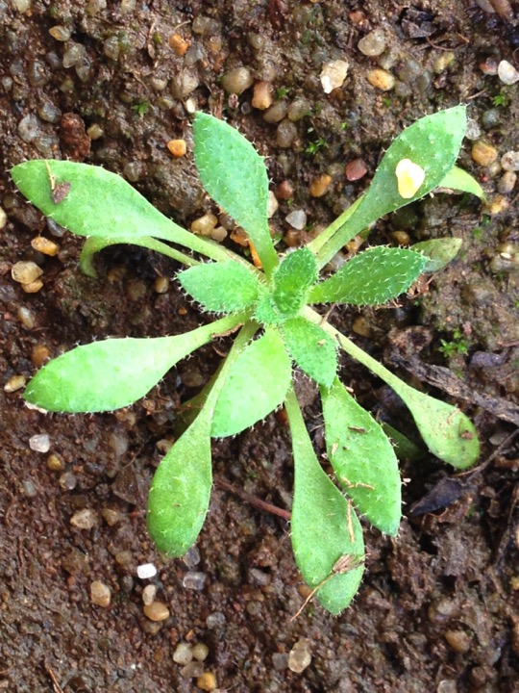
Notes:
Plagiobothrys nothofulvus?

Slide 14
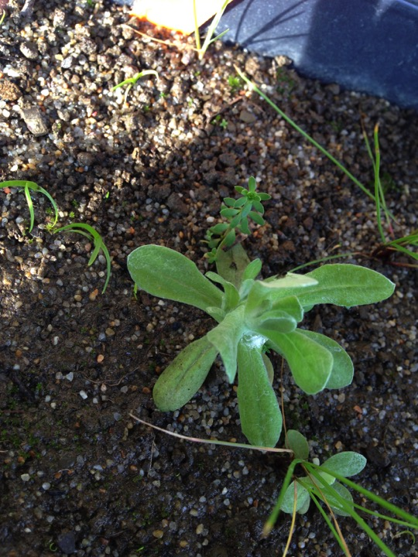

Slide 15
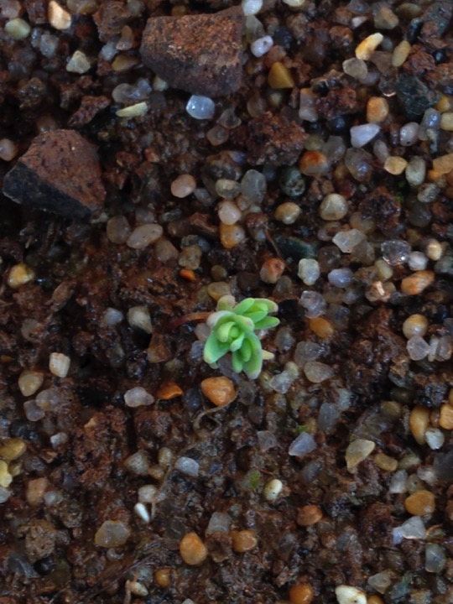
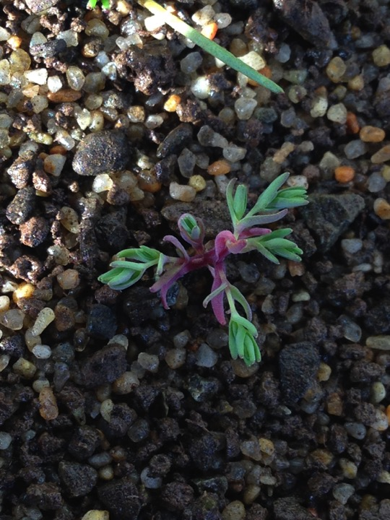
Notes:
Succulent-like

Slide 16
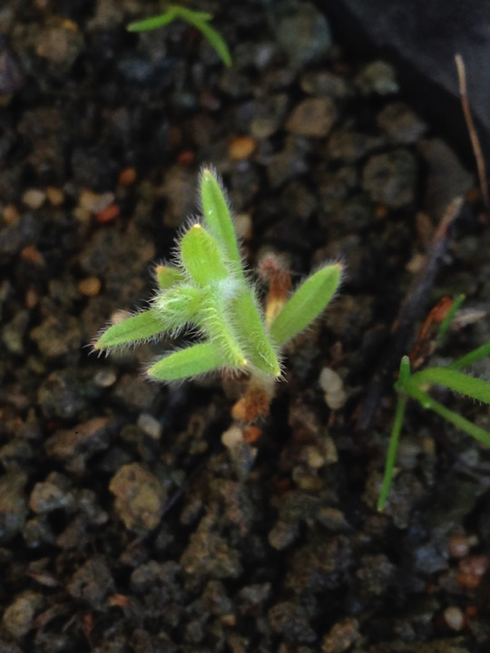

Slide 17
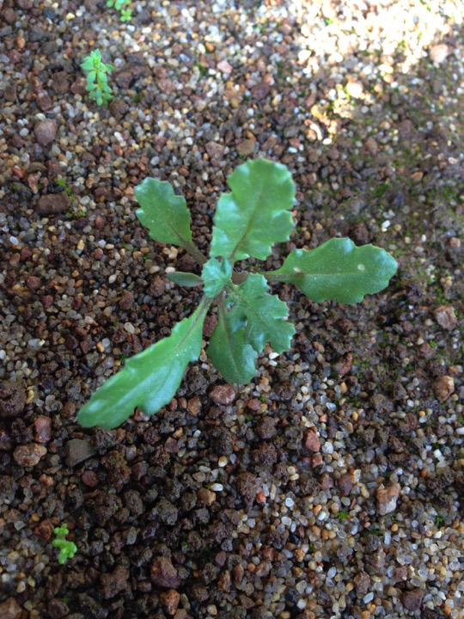

Slide 18
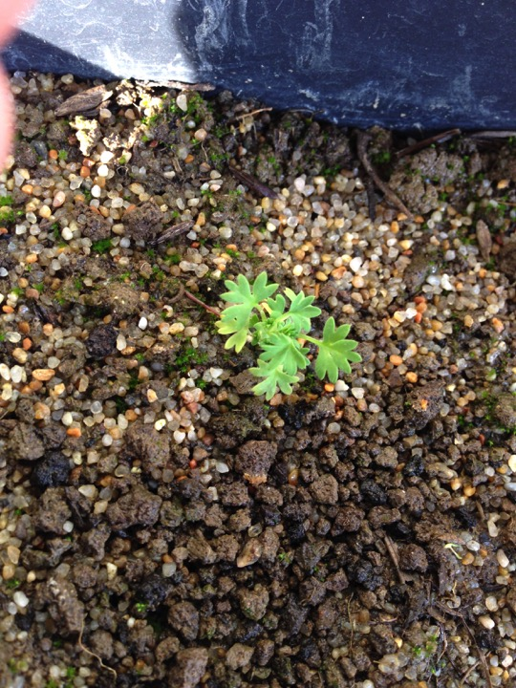

Slide 19
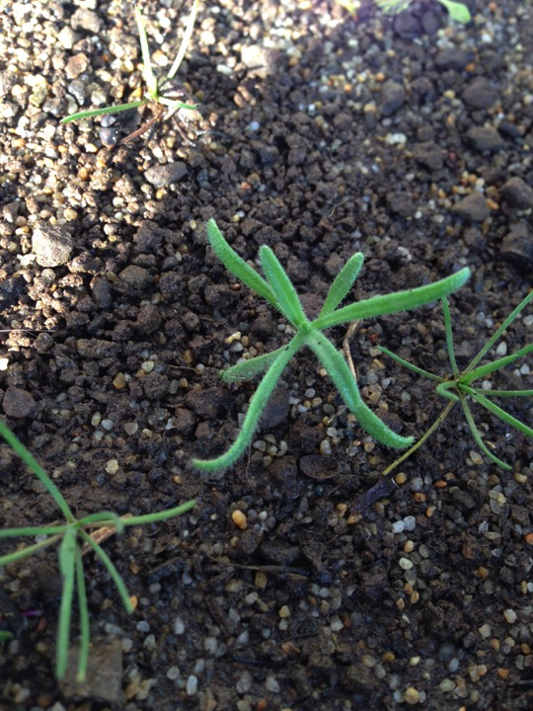

Slide 20
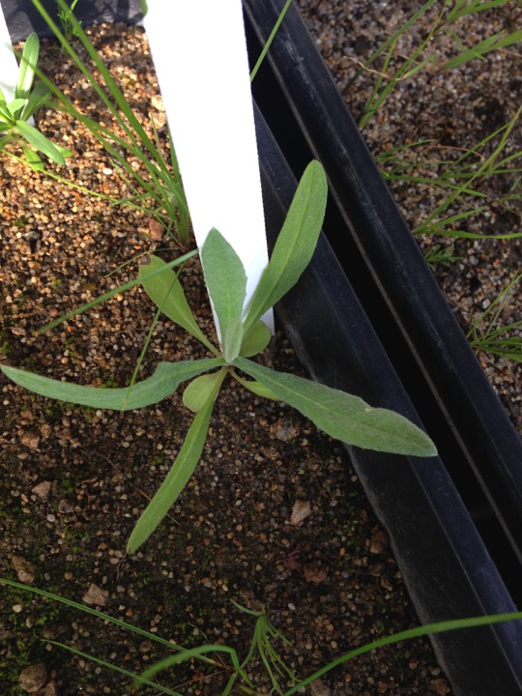

Slide 21
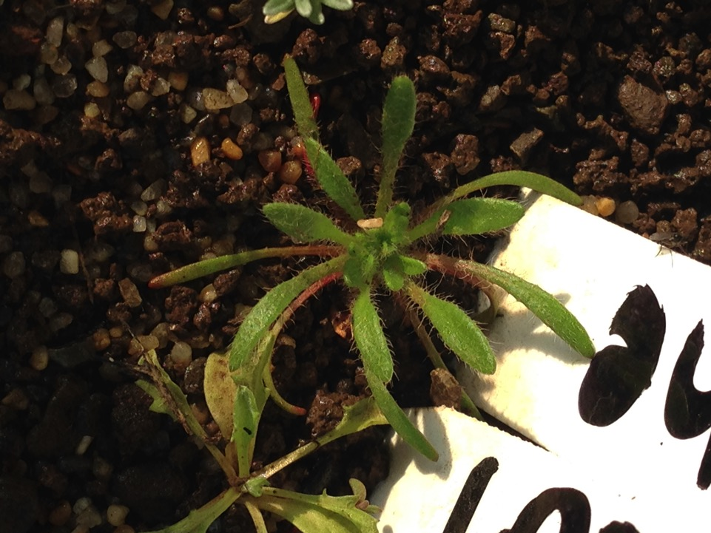

Slide 22
